Slide 1
Business Review: Focus on Telecom 2013
John Gole
November 2013

Slide 2
Telecom Services Revenue in CEE 2013 Growth Rate (forecast)
Slovenia
Slovakia
Russia
Romania
Poland
Hungary
Estonia
Czech Republic
Croatia
Bulgaria
Throughout the region, nearly all markets are suffering decline in telecoms services revenues.
Romania actually suffers less than many others.
Source: IDC EMEA Telecom Services Database, Q3 2013

Slide 3
What Explains The Weakness in The Telecoms Services Market?
Regulation
Regulation is one key factor: termination rates, roaming, licensing…
Telecoms Industry Under Pressure

Slide 4
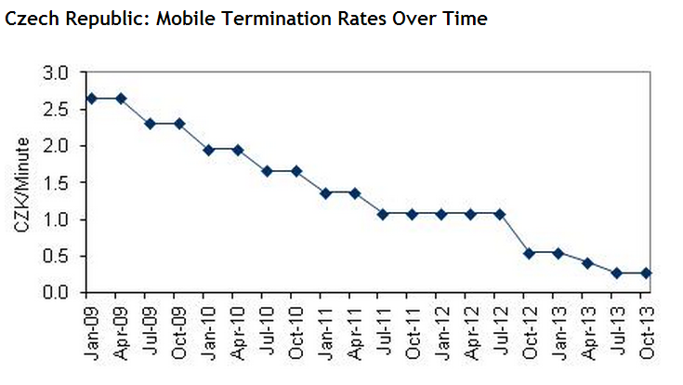
How Much Have Termination Rates Fallen? An Example From The Region
Source: CTU, IDC

Slide 5
Not Just A Matter of Regulation
Devaluation of Voice and Messaging
Falling Prices
Investments Required
Economics
OTT Players
Telecoms Industry Under Pressure
Regulation
Changing Consumer Behavior

Slide 6
Energy
Device Sales
M2M Solutions
Challenges
Opportunities
Unified Communications
Can telcos manage all of the challenges?
Heavy Investments
Mobility Management
Will the opportunities outweigh the challenges?
Devaluation of Voice and Messaging
M2M Connectivity
Falling Prices
Content (video, music, apps, games)
Economics
Cloud Services
Changing Customer Behavior
Regulation
Mobile Broadband
OTT Threats

Slide 7
Outlook for 2014?

